Slide 1
Amazon DynamoDB
Fast, flexible NoSQL database service for single-digit millisecond performance at any scale.

Slide 2






Core elements of end-to-end data strategy
Comprehensive Set of Services
Integrated Data Sources
Governance Strategy
Notes:
Our vision is to help you manage ALL your data, regardless of where it lives. We recognize that you are living in a world that uses some combination on premises, one or more clouds, and 3rd parties, and all of it needs to be cataloged and governed, breaking down historic silos.
Our goal is to meet you where you are, and help you reach your desired state. It does not matter whether your applications are monolithic, client/server, 3 tier, or microservices, we can help. It does not matter if your goal is replacing an aging server, deprecating a data center, or wanting to build an application for 100M’s of simultaneous users. We have the approaches you are looking for.
Many of our competitors want to convince you that their technology can solve any data challenge. Our strategy has been to offer the right tool for the right job via a choice, both relational and non-relational. This strategy has resonated with customers to date – the top 1,000 AWS customers use ten or more database and analytics services.
By working with leaders across all industries and sizes, we’ve discovered at least three core elements of an end-to-end data strategy.
First, you need a comprehensive set of services to meet your needs now and in the future;
Second, solutions that integrate your data so you can easily access it, no matter where it lives;
And third, the right governance strategy so you can free your teams to move faster with their data.

Slide 3


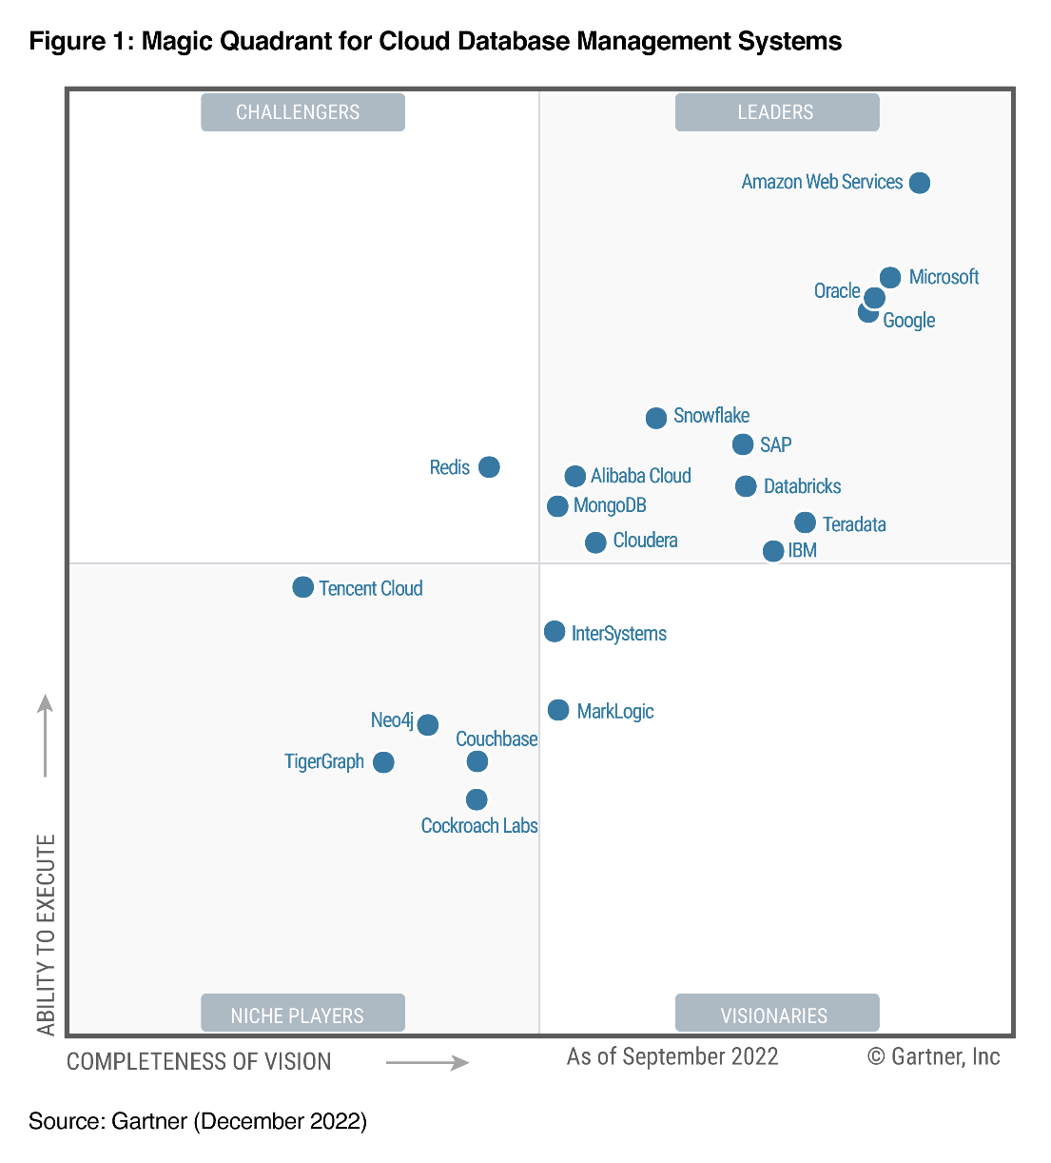

Highest in Execution Furthest in Vision in 2022 A Leader: 8 Years in a Row
Gartner Magic Quadrant for Cloud Database Management Systems
Gartner, Magic Quadrant for Cloud Database Management Systems, Henry Cook, Merv Adrian, Rick Greenwald, Xingyu Gu, 13 December 2022. Gartner and Magic Quadrant are registered trademarks of Gartner, Inc. and/or its affiliates in the U.S. and internationally and is used herein with permission. All rights reserved. The report was previously named as Magic Quadrant for Operational Database Management Systems until 2019. This graphic was published by Gartner, Inc. as part of a larger research document and should be evaluated in the context of the entire document. The Gartner document is available upon request from AWS. Gartner does not endorse any vendor, product or service depicted in its research publications, and does not advise technology users to select only those vendors with the highest ratings. Gartner research publications consist of the opinions of Gartner's research organization and should not be construed as statements of fact. Gartner disclaims all warranties, expressed or implied, with respect to this research, including any warranties of merchantability or fitness for a particular purpose.
Notes:
And this focus pays off. We are excited to share that Gartner named AWS as a leader for both vision and ability to execute for the first time ever.

Slide 4
Most complete set of relational & purpose-built databases
KEY-VALUE
DOCUMENT
CACHING
GRAPH
Amazon DynamoDB
Amazon DocumentDB
Amazon ElastiCache
Amazon Neptune
Amazon RDS
Amazon Aurora
TIME-SERIES
MEMORY
WIDE COLUMN
LEDGER
Amazon Timestream
Amazon MemoryDB
Amazon Keyspaces
Amazon QLDB
Notes:
So how do you build a modern data strategy? A modern data strategy starts with migrating to the cloud, moving toward infrastructure that enables you to achieve the scale you need, at the right cost, while reducing operational burden. First, modernizing your data infrastructure allows you to remove costly undifferentiated heavy lifting. Organizations running legacy on-prem data stores, as well as those that are self-managing in the cloud, still need to take care of management tasks, such as database provisioning, patching, configuration or backups. AWS takes care of a lot of this for you. AWS unmatched experience, maturity, reliability, security, and performance is the solid foundation that you can depend on for your most important applications.
From our early learnings operating infrastructure for Amazon.com, we realized that while the traditional relational databases were a valuable tool, there were a number of use-cases where they fell short. Scaling challenges of traditional old guard relational databases drove us to create new relational databases, reimagined for the cloud in Amazon Aurora and Amazon RDS. The ability to use the database engines we knew, with the elasticity, durability, and availability of managed cloud services, was a massive leap forward, and we knew customers would feel the same.
For workloads where a tabular data model would be ineffective, we created Amazon DynamoDB, our fast, flexible, NoSQL database with consistent single digit millisecond performance at any scale. Over time, we continued to find use-cases where there were unmet needs at the intersection of data types, access patterns, and developer preferences, so we continued to create additional nonrelational databases to ensure customers were always able to use the right tool for the right job. Today, AWS customers have the choice of a number of non-relational database services that suit the precise data model, access patterns, and operational needs. These include Elasticache for in memory workloads, DocumentDB for JSON document workloads, and Neptune for graph databases.

Slide 5
Modernizing leads to maximum innovation velocity and optimal total cost of ownership
Innovation velocity
Total
cost of
ownership
(TCO)
On-premises
Lift
and shift
Move to managed
databases
Break-free from
legacy databases
Modernize with purpose-built databases
Notes:
1/ As customers move to the cloud and lift and shift their databases to EC2, they will start to see both reduction in costs AND increases in innovation. 2/ From here as they move into managed databases, costs are further reduced and the velocity of innovation continues to accelerate. 3/ Customers see the greatest savings in costs and the highest velocity of innovation with cloud native databases like Aurora and DynamoDB, when they break up the monolith and move to a microservices architecture that let’s them innovate on components simultaneously.

Slide 6
Amazon DynamoDB
Performance at scale
Consistent, single-digit millisecond read and write performance
Nearly unlimited throughput and storage
Massive scalability
Secure and Resilient
Data encryption at rest
Global replication
Up to 99.999% availability SLA
Serverless
Performance at scale with the ability to scale-up and scale-to-zero
No downtime maintenance, no maintenance windows
No provisioning or capacity management
Pay-per-request billing
Built-in integration with others AWS services
Logging, monitoring, and analytics
Import and export data to Amazon S3
Notes:
Amazon DynamoDB is a fully managed NoSQL database service running in the AWS Cloud. The complexity of running a massively scalable, distributed NoSQL database is managed by the service itself, allowing software developers to focus on building applications rather than managing infrastructure. NoSQL databases are designed for scale, but their architectures are sophisticated, and there can be significant operational overhead in running a large NoSQL cluster. Instead of having to become experts in advanced distributed computing concepts, the developer need only to learn DynamoDB’s straightforward API using the SDK for the programming language of choice. In addition to being easy to use, DynamoDB is also cost effective.
With DynamoDB, you pay for the storage you are consuming and the IO throughput you have provisioned. It is designed to scale elastically while maintaining high performance. When the storage and throughput requirements of an application are low, only a small amount of capacity needs to be provisioned in the DynamoDB service. As the number of users of an application grows and the required IO throughput increases, additional capacity can be provisioned on the fly. This enables an application to seamlessly grow to support millions of users making thousands of concurrent requests to the database every second. DynamoDB is secure with support for end to end encryption and fine grained access control. Finally,
Core Key Features:
Any scale from zero to infinity with Auto Scaling
Serverless billing and scaling with on-demand mode provides instant scale up and scale down allowing applications to handle usage spikes and charges for only the throughput used. Consistent single digit millisecond performance is delivered no matter the scale.
Physical data security with Encryption
DynamoDB encrypts all customer data at rest by default. Encryption at rest enhances the security of your data by using encryption keys stored in AWS Key Management Service. With encryption at rest, you can build security-sensitive applications that meet strict encryption compliance and regulatory requirements. The default encryption using AWS owned customer master keys is provided at no additional charge.
Multi-region, active-active with Global Tables
Global tables provide a fully managed solution for deploying a multi-Region, multi-active database, without having to build and maintain your own replication solution. You can specify the AWS Regions where you want the tables to be available and DynamoDB will propagate ongoing data changes to all of them.
5 9’s of availability
DynamoDB provides an SLA of at least 99.999% if the Global Tables SLA applies, or (b) at least 99.99% if the Standard SLA applies (the "Service Commitment"). In the event DynamoDB does not meet the Service Commitment, you will be eligible to receive a Service Credit.
Serverless
DynamoDB was the first serverless database service, with infinite scaling with only single millisecond lag as workloads grow. With DynamoDB there are no downtime windows or maintenance window requirements.
Pay-per-request, on-demand billing
Over time, DynamoDB's infrastructure automatically expands and adapts to changing or imbalanced access patterns. The table's capacity is applied to meet your applications access patterns.
Change tracking with triggers
DynamoDB now allows you to log all read and write requests to log files you can analyze, in addition to the ability to log all operator actions performed on your table.
Flexible storage options with table classes and export/import to/from S3 bucket
Customers can choose Standard IA (infrequent access) in place of default storage for each table, which is a billing model that reduces the cost of storage by 60% while charging 24% more for read and write operations. For huge, infrequently accessed tables, this can save significant costs. Read and write performance is the same in either mode.
Exporting a DynamoDB table to an S3 bucket enables you to perform analytics and complex queries on your data using other AWS services such as Athena, AWS Glue, and Lake Formation. DynamoDB table export is a fully managed solution for exporting DynamoDB tables at scale, and is much faster than other workarounds involving table scans. Also, it should be noted that tiered storage is a setting that allows customers to choose Standard IA (infrequent access) in place of default storage for each table, thus saving money for tables that are large and infrequently accessed.
Importing data from S3 is a new fully managed feature (added Q322) that doesn’t require writing code or managing infrastructure to import data into a new DynamoDB table. This process is 66% more cost effective than manual import using provisioned capacity. Simply put, DynamoDB import from S3 provides the ability to bulk import terabytes of data from S3 into a new DynamoDB table with no code or servers required.

Slide 7



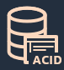
Amazon DynamoDB Features
Additional Integrations
On-demand backup
Time To Live (TTL)
Amazon DynamoDB Streams and Kinesis Data Streams support
PITR recovery
In-memory performance
Amazon CloudWatch
Contributor Insights
for DynamoDB
SQL friendly developer tools
ACID transactions
Notes:
Additional features and integrations have been added to expand the service’s capabilities since it launched in 2012. Let’s review some of these key features –
On-demand backup and restore
On-demand backup allows you to create full backups of your DynamoDB tables’ data for data archiving, helping you meet your corporate and governmental regulatory requirements. You can back up tables from a few megabytes to hundreds of terabytes of data, with no impact on performance and availability to your production applications. On-demand backup processes back up requests in seconds regardless of the size of your tables so that you don’t have to worry about backup schedules or long-running processes. In addition, you can enable continuous backups for point-in-time recovery. This gives you the ability to restore to any point in the last 35 days down to the per second granularity. All backups are automatically encrypted, cataloged, easily discoverable, and retained until you explicitly delete them. You can execute backup and restore operations with a single click in the AWS Management Console or with a single API call.
Point-in-time-recovery
Point-in-time recovery (PITR), an optional feature, helps protect your DynamoDB tables from accidental write or delete operations. PITR provides zero-impact continuous backups of your DynamoDB table data, and you can restore that table to any point in time up to the second during the preceding 35 days. You can enable PITR or initiate backup and restore operations with a single click in the AWS Management Console or a single API call.
SQL Friendly Developer Tools with SQL Workbench
NoSQL Workbench for Amazon DynamoDB is a cross-platform client-side GUI application for modern database development and operations and is available for Windows, macOS, and Linux. NoSQL Workbench is a unified visual IDE tool that provides data modeling, data visualization, and query development features to help you design, create, query, and manage DynamoDB tables.
Time to live (TTL)
Optional feature that finds and deletes data, based on expiration dates set in the application, for no extra charge. Provides an automated means to keep tables from growing unbounded
In-memory performance with DAX
DAX, short for DynamoDB Accelerator is a fully managed, highly-available, in-memory cache for DynamoDB that delivers up to 10x performance improvement going from milliseconds to microseconds, even at millions of requests per second. DAX does all the heavy lifting required to add in-memory acceleration without requiring developers to manage cache invalidation, data population or cluster management.
Transaction integrity – ACID
Transactional operations provide atomicity, consistency, isolation and durable guarantees within the region where the write is made originally. Transactions are not supported across regions in global tables.
Additional Integrations
DDB Streams and Kinesis
Developers can build event-driven routines to react to real time changes in a DynamoDB table with DynamoDB Streams or Kinesis Data Streams. A custom Lambda function can perform any actions you specify, such as sending a notification or initiating a workflow. Note that
Streams is only for 24hrs of data for bringing data into Lambda and Kinesis is a formal integration to pull data from DynamoDB.
CloudWatch Contributor Insights
CCI is an add-on that shows the most frequently accessed keys from your table's usage patterns, so you can understand any hot key issues and troubleshoot any throttling issues.

Slide 8

Deep Dive: Global tables multi-Region replication
Build high-performance, globally distributed applications
Low-latency reads and writes to locally available tables
Multi-Region redundancy and resiliency and 99.999 percent availability
Multi-active writes from any Region
Easy to set up and no application rewrites required
Notes:
Global tables build on DynamoDB’s global footprint to provide you with a fully managed, multi-region, and multi-master database that provides fast, local, read and write performance for massively scaled, global applications. Global tables replicate your DynamoDB tables automatically across your choice of AWS Regions. Global tables eliminate the difficult work of replicating data between regions and resolving update conflicts, enabling you to focus on your application’s business logic. In addition, global tables enable your applications to stay highly available even in the unlikely event of isolation or degradation of an entire Region.

Slide 9






DynamoDB use cases by industry
Finance
Fraud detection
User transactions
Mainframe offloading
(Capital One, Vanguard, Fannie Mae)
Gaming
Game states
Leaderboards
Player data stores
(Riot Games, Electronic Arts, PennyPop)
Software and Internet
Metadata caches
Ride-tracking data stores
Relationship graph data stores
(Uber, Lyft, Swiggy, Snap, Duolingo)
Ad tech
User profile stores
Metadata stores for assets
Popular-item cache
(AdRoll, GumGum, Branch, DataXu)
Retail
Shopping carts
Workflow engines
Customer profiles
(Nordstrom, Nike, Zalando, Mercado Libre)
Media and Entertainment
User data stores
Media metadata stores
Digital rights management stores
(Airtel Wynk, Amazon Prime, Netflix)
Notes:
Customer use cases for Amazon DynamoDB span across multiple industries.
Here are examples of some of the key use cases where Amazon DynamoDB is an excellent fit, along with specific customer references for each.

Slide 10








































































Hundreds of thousands have chosen DynamoDB
Notes:
Hundreds of thousands of customers have chosen DynamoDB, across industries and use cases.

Slide 11



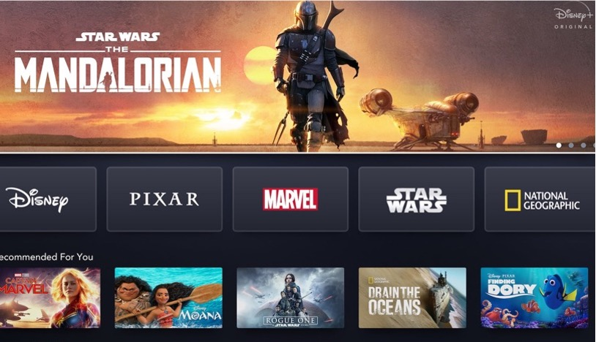
Disney +
Disney+ delivers an extensive library of digital content directly to the homes of 152 million subscribers.
Challenge
Since it’s launch in November 2019, Disney+ has grown to 152 million subscribers. They needed help with launching into new countries and shifting traffic while providing low latency. With billions of daily recommendations and bookmarks, they needed a service with little to no operational overhead.
Solution
Disney+ chose Amazon DynamoDB with the global tables option to deliver multi-active, multi-region replication.
Result
Single digit latency when shifting traffic without experiencing data issues.
Scale recommendations and bookmarks with little to no operational overhead.
Simply add another AWS region in global tables when they launch into new countries, which provides low latency.
Notes:
Disney+, one of the largest global online video streaming platforms, was launched in November 2019 as the home of Disney, Pixar, Marvel, Star Wars, and National Geographic.
Disney+ launched in November 2019 and delivers its extensive library of digital content directly to the homes of over 150 million subscribers (as of Q3 2022), and DynamoDB is one of the technologies that supports this global footprint.
Disney+ chose DynamoDB to help with:
Utilizing multi-Region replication with single-digit latency to shift traffic without experiencing data issues
Adding another AWS Region in global tables to launch into new countries, providing low latency
Scaling Recommendations and Bookmarks with little to no operational overhead
Having the ability to switch back and forth between on-demand and provisioned capacity modes when entering new Regions
---
For reference:
Re:Invent 2020 session - https://virtual.awsevents.com/media/1_1fk94c1l
Utilizing multi-Region replication with single-digit latency that allows Disney+ to shift traffic without experiencing data issues
Adding another AWS Region in global tables as Disney+ launches into new countries, which provides low latency
Scaling Recommendations and Bookmarks supported by DynamoDB global tables with little to no operational overhead
Having the ability to switch back and forth between on-demand and provisioned capacity modes when entering new Regions

Slide 12


Dropbox
Dropbox provides one place to keep life organized and keep work moving for over 700 million registered users across 180 countries.
Challenge
Dropbox experienced a capacity crunch on its on-premises metadata store due to fast data growth. They had less than two years until their on-premises system would reach maximum capacity.
Solution
Dropbox migrated their metadata stores from on-premises MySQL clusters to Amazon DynamoDB and Amazon S3.
Result
Utilize Amazon DynamoDB for the hot storage layer, ingesting logging data to six DynamoDB tables at 4000-6000 writes per second per table with each table storing 50-80GB daily.
Offload data to Amazon S3 at the end of the day for permanent storage after which the tables in DynamoDB are deleted.
By using Amazon DynamoDB and Amazon S3, the Dropbox Alki team was able to rapidly launch a durable, scalable metadata storage that has resulted in massive cost savings for Dropbox.
Notes:
Dropbox experienced a capacity crunch in its on-premises metadata store due to fast data growth. They had less than two years until their on-premises system would reach maximum capacity, so they pursued a fully managed cloud solution with AWS.
Dropbox chose DynamoDB and Amazon S3:
To migrate audit log data from a legacy database in less than 2 weeks, and launch metadata storage system in one year
To scale for virtually unlimited user metadata, with high performance, ingesting data during migration of up to 600K queries per second
To save money, specifically millions of dollars in expansion costs and significantly reduced per-user gigabyte costs by a factor of 5.5
----
For reference
Dropbox AWS case study - https://aws.amazon.com/solutions/case-studies/dropbox-dynamodb-case-study/
Dropbox re:Invent 2020 session - https://virtual.awsevents.com/media/1_9qr7wzqh
With more than 700 million registered users across 180 countries, Dropbox is on a mission to design a more enlightened way of keeping work moving and providing one place to keep life organized.

Slide 13



Snap, Inc
Snap Inc. creates Snapchat, an app that offers its community around the world a fast and fun way to connect with close friends.
Challenge
Snap needed to modernize its legacy monolithic infrastructure in order to scale to support growth, including high-traffic days. In addition, Snap was looking to move to a service-oriented, regionalized, cost-efficient and durable architecture.
Solution
Snap modernized Snapchat’s architecture using microservices built around services like Amazon DynamoDB.
Result
Moving to DynamoDB has helped Snap optimize annual infrastructure costs significantly.
DynamoDB is able to handle more than 10 million queries per second during peak hours with high availability and operational reliability.
Reduced the median latency of sending Snaps by over 20%.
Support 290 million Snapchatters on averaging sending billions of pictures and video messages.
Notes:
Snap tackles massive-scale spikes
Snap modernized Snapchat’s architecture using microservices built around services like Amazon DynamoDB
Migrating to Amazon DynamoDB has helped Snap optimize annual infrastructure costs significantly—in addition to providing low latency and operational reliability for core use cases like messaging and our friend graph."
Saral Jain Director of Engineering and Head of Infrastructure, Snap Inc.
Reduce cost
Optimized annual infrastructure costs significantly
Tackle scale
Amazon DynamoDB to handle more than 10 million queries per second during peak hours—and with high availability and operational reliability
---
For reference:
Snap case study - https://aws.amazon.com/solutions/case-studies/snap-dynamodb/?did=cr_card&trk=cr_card (note, there are several Snap case studies, this is the latest from 2022)

Slide 14

DynamoDB Getting Started Resources
Website: aws.amazon.com/dynamodb
Technical Documentation: docs.aws.amazon.com/dynamodb
Customer Stories: https://aws.amazon.com/dynamodb/customers/
Developer Forum: forums.aws.amazon.com/forum.jspa?forumID=131
Re:Post: https://repost.aws/
AWS Databases & Analytics on LinkedIn: linkedin.com/showcase/aws-databases
Follow us on Twitter for latest news, and tips: @DynamoDB
Browse Amazon DynamoDB Resources
Notes:
Hundreds of thousands of customers have chosen DynamoDB, across industries and use cases.

Slide 15
Speaker name (pronouns)
Notes:
Q&A here

